Slide 1

Metro Traffic Volume Prediction

Slide 2



Metro Traffic Volume Prediction HELLO! K. Sri Satya K. S. N.Swamy P. Durga Prasad

Slide 3
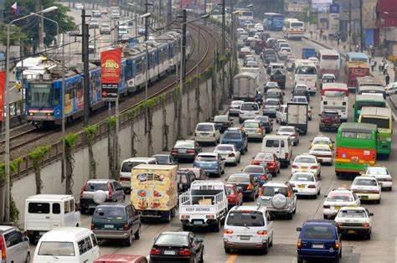
Metro Traffic Volume Prediction
Objective:
Our objective of this project is to build a model that will predict traffic volume for future based on previous traffic volume data. In this process we use linear regression algorithm in machine learning using python programming language. Python is a open source software to build any application in machine learning. We also used flask to develop web page.

Slide 4
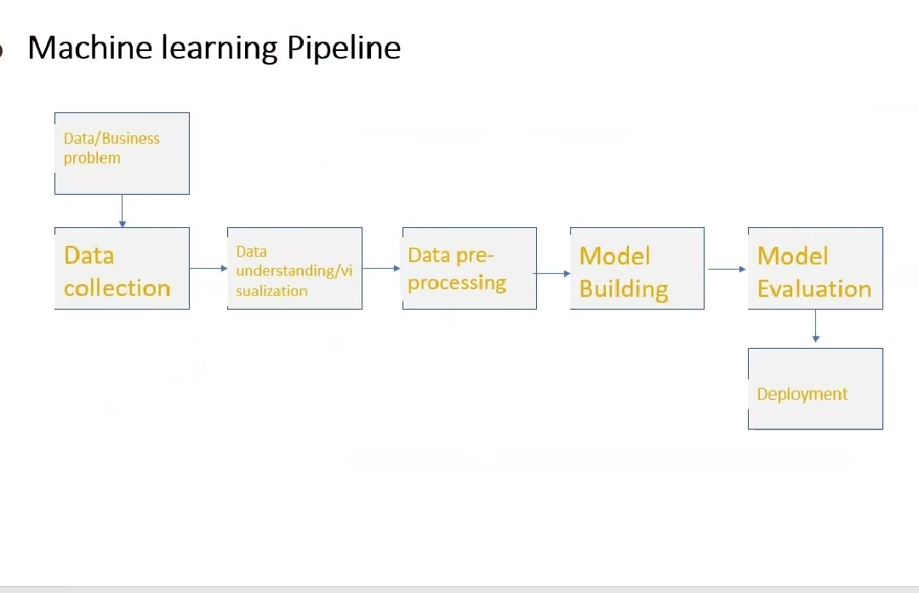
Metro Traffic Volume Prediction

Slide 5
Metro Traffic Volume Prediction TOOLS USED: Spyder: To develop a program in machine learning. Sublime text: To develop a webpage. Flask: To develop a web frame work in python. Method to develop: We used the the regression technique to predict the traffic volume in that regression we used linear regression

Slide 6
Metro Traffic Volume Prediction
INPUTS REQUIRED:
Holiday
Temperature
Rain
Snow
Clouds
Weather
Date and Time

Slide 7
Metro Traffic Volume Prediction
MODULES TO IMPORT
Pandas
Numpy
Label encoder module
Metrics

Slide 8

Metro Traffic Volume Prediction
Pandas : Pandas is an open-source Python Library providing high-performance data manipulation and analysis
tool using its powerful data structures. The name Pandas is derived from the word Panel Data – an Econometrics
from Multidimensional data.
Key Features of pandas
Fast and efficient DataFrame object with default and customized indexing.
Tools for loading data into in-memory data objects from different file formats.
Data alignment and integrated handling of missing data.
Reshaping and pivoting of date sets.
Label-based slicing, indexing and subsetting of large data sets.
Columns from a data structure can be deleted or inserted.
Group by data for aggregation and transformations.

Slide 9

Metro Traffic Volume Prediction
Numpy: Numpy is a general-purpose array-processing package. It provides a high-performance multidimensional array object, and tools for working with these arrays
METRICS MODULE :
The metrics that you choose to evaluate your machine learning algorithms are very important.
Choice of metrics influences how the performance of machine learning algorithms is measured and compared. They influence how you weight the importance of different characteristics in the results and your ultimate choice of which algorithm to choose.
.

Slide 10

Label encoder module:
In machine learning, we usually deal with datasets which contains multiple labels in one or more than one columns. These labels can be in the form of words or numbers. To make the data understandable or in human readable form, the training data is often labeled in words.
Label Encoding refers to converting the labels into numeric form so as to convert it into the machine-readable form. Machine learning algorithms can then decide in a better way on how those labels must be operated. It is an important pre-processing step for the structured dataset in supervised learning.

Slide 11
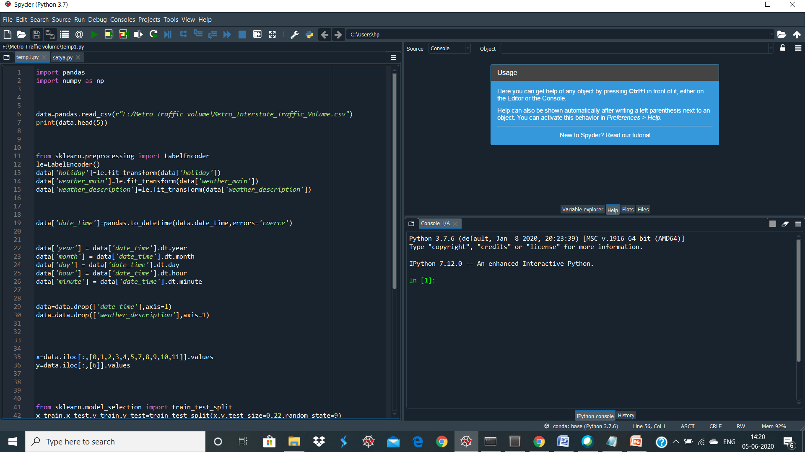
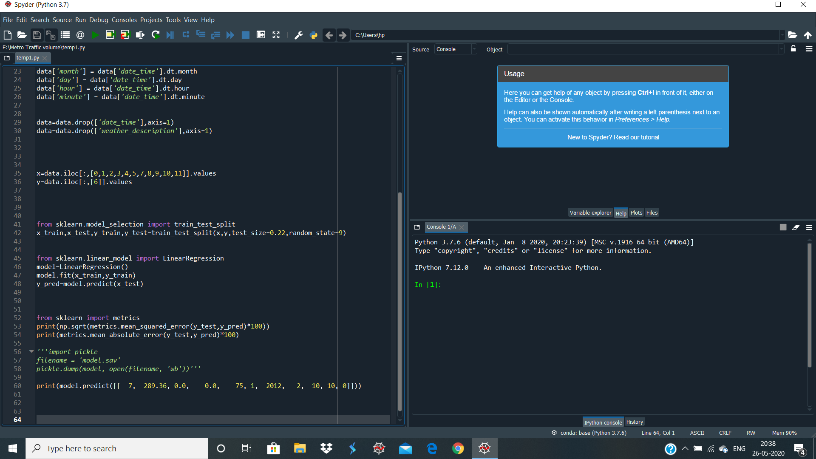
Metro Traffic Volume Prediction
Code:

Slide 12
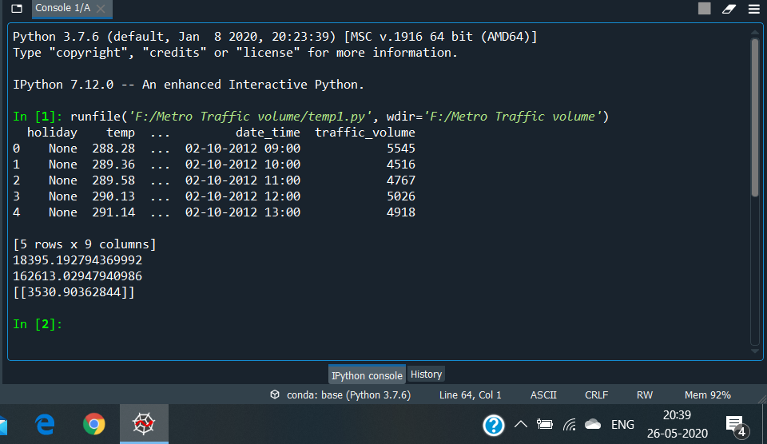
Metro Traffic Volume Prediction
Output:

Slide 13
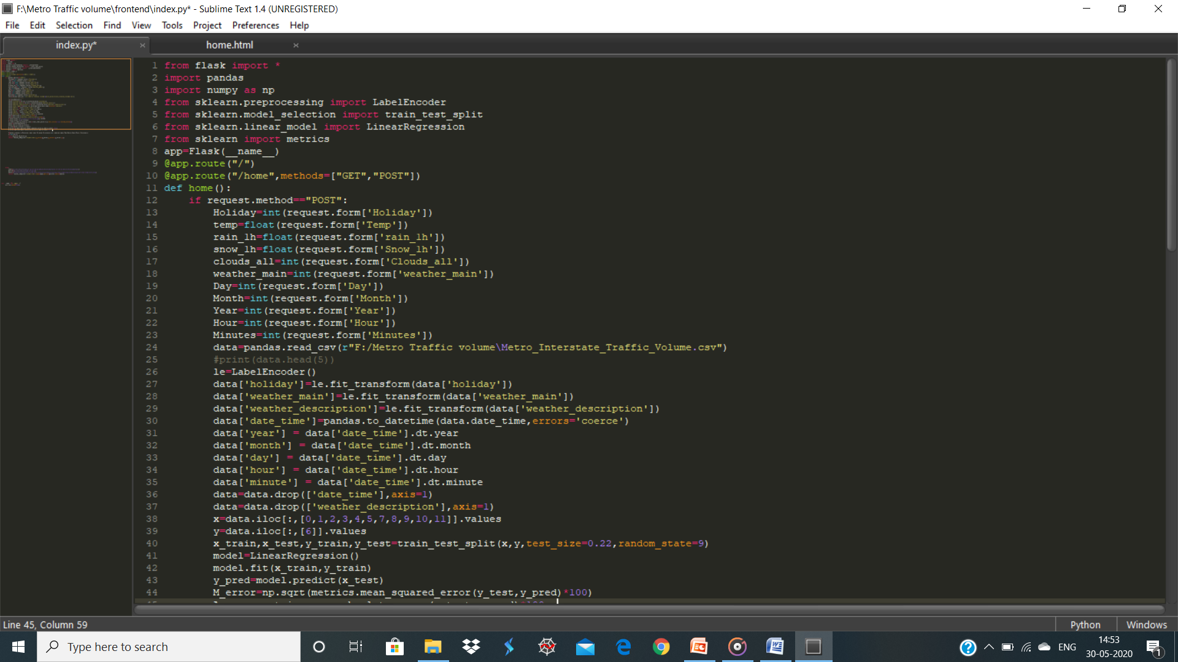
Metro Traffic Volume Prediction
Web Page Using Flask In sublime Text:

Slide 14
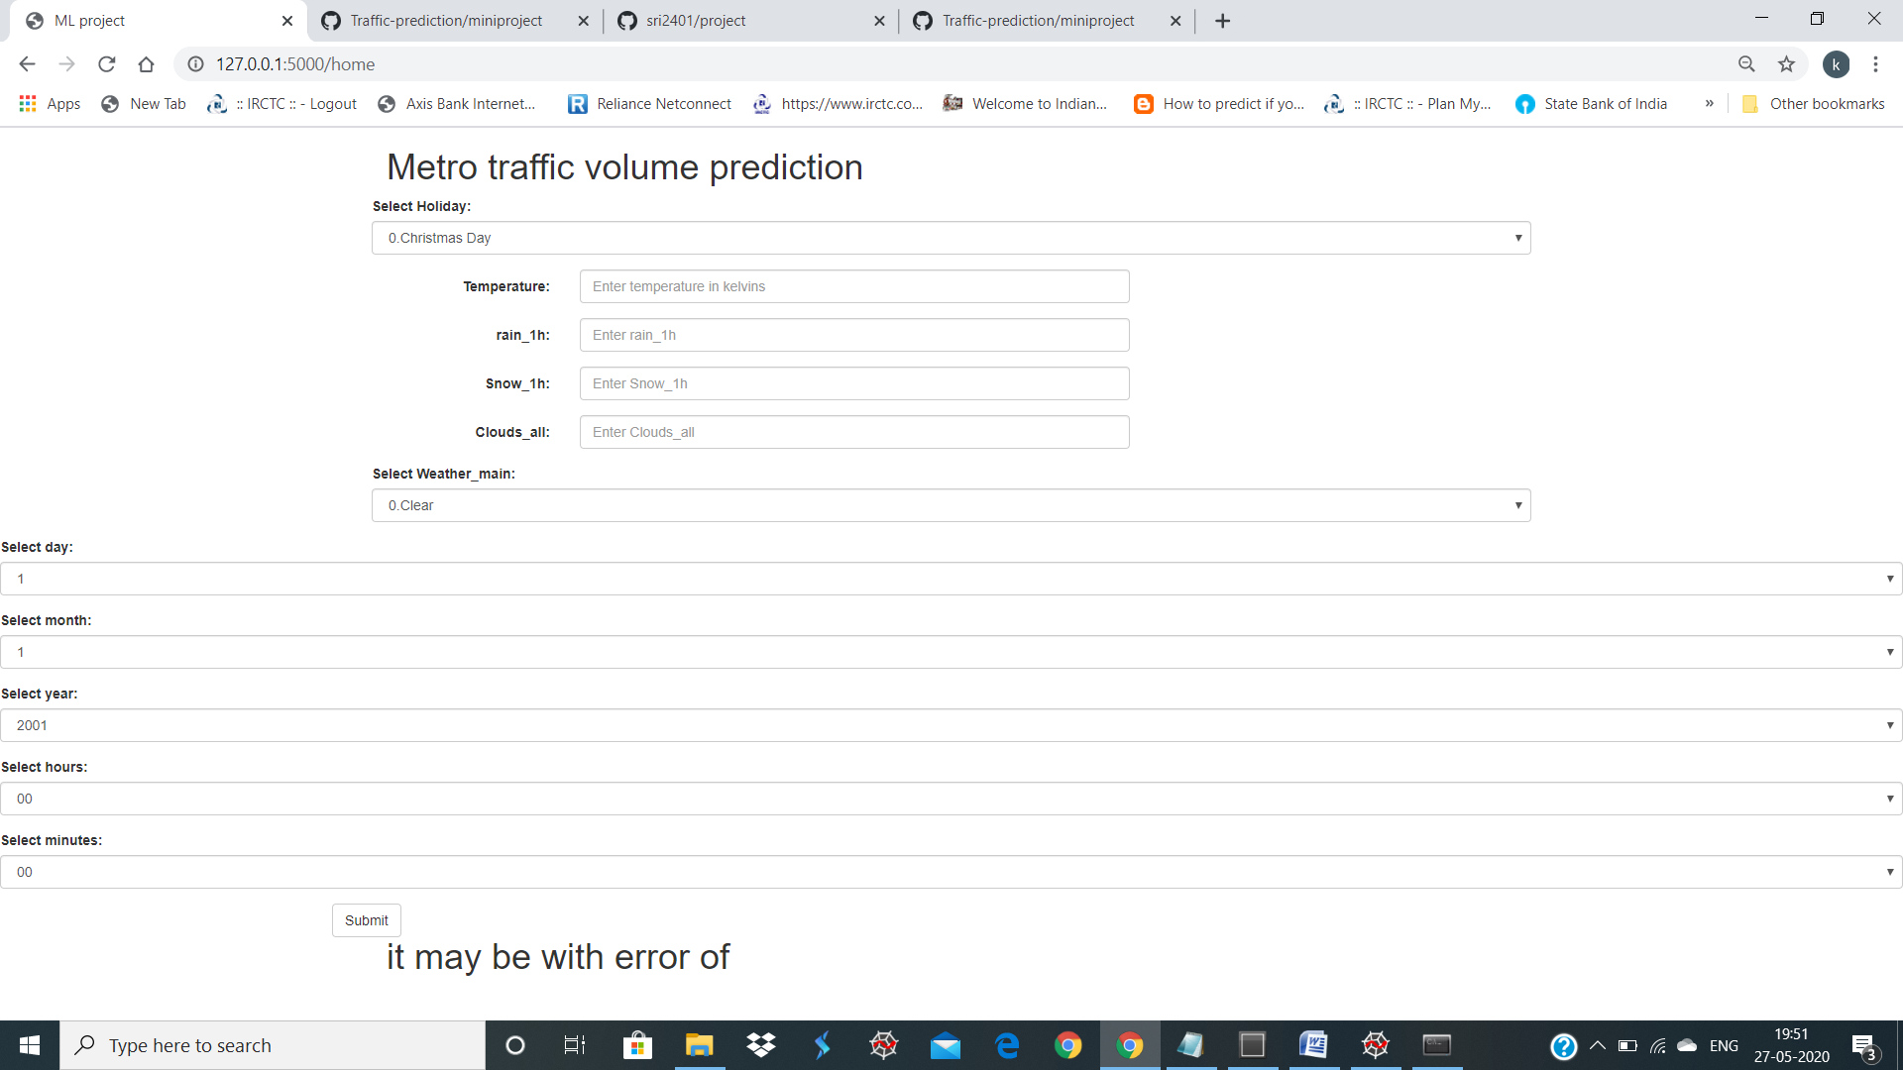
Metro Traffic Volume Prediction
Web Page:

Slide 15
Metro Traffic Volume Prediction
ADVANTAGE:
By using this we can easily predict the future Traffic volume, it may not be accurate but it gives the estimation of the traffic by giving the inputs based on above shown

Slide 16

Thank you

